Slide 1
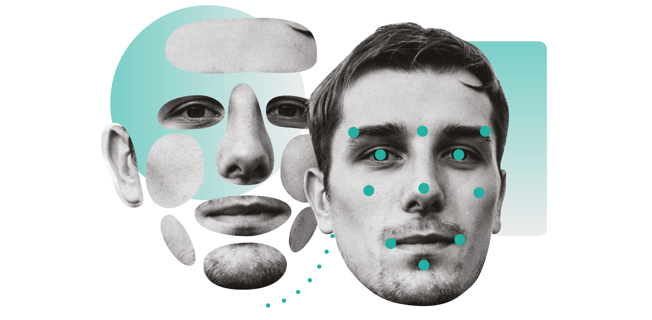
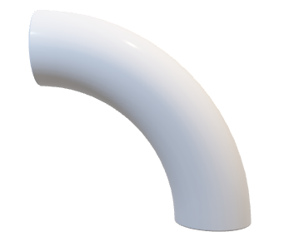


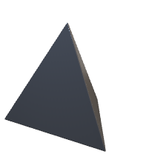
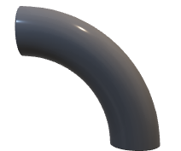

GENDER SHADES
Intersectional Accuracy Disparities in Commercial Gender Classification

Slide 2
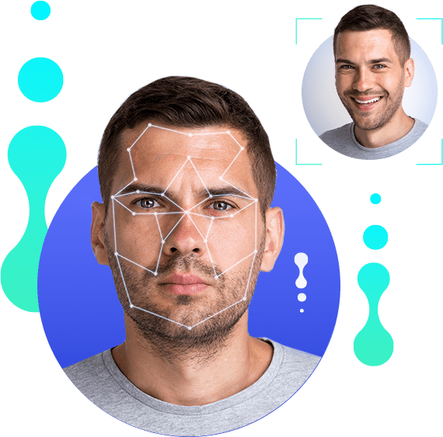







Introduction
Machine Learning
&
Artificial Intelligence
Increasing making decisions for us
Creates efficiency and ease in our lives
Detrimental Effects
High stakes tasks
How to ensure accuracy?
Example – Prisoner and Algorithms
COMPAS software
Generate a recidivism-risk score 1-10
Comparing an individual's attributes and qualities to known high-risk offenders

Slide 3
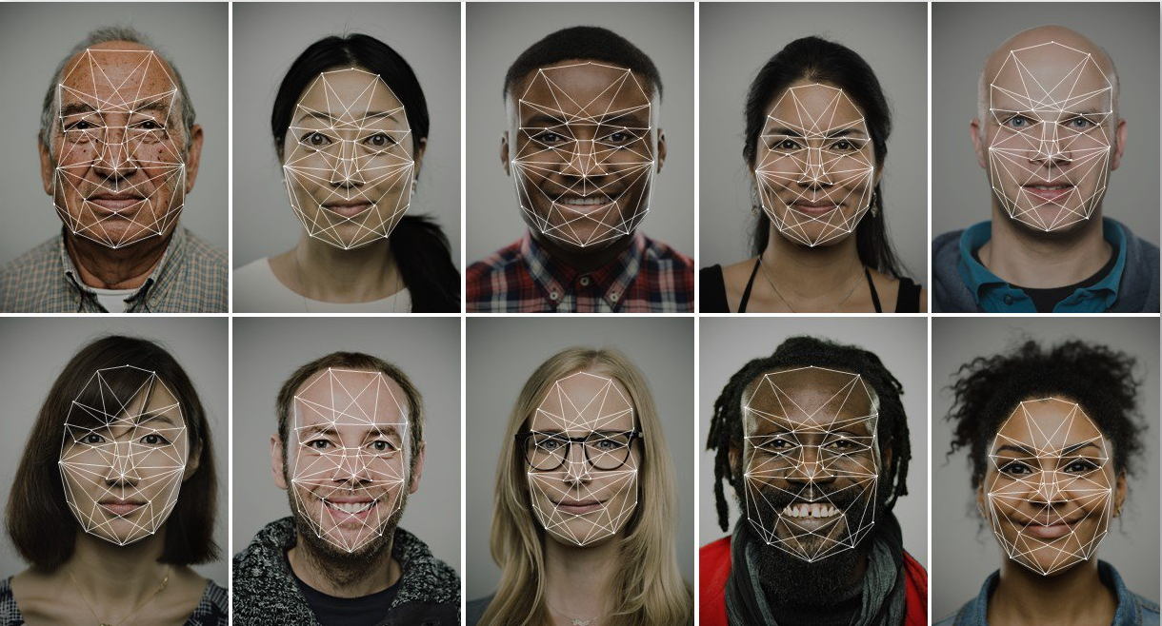



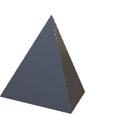


Computational Technology
Facial Recognition
Machine Learning
Computer Vision
How it works:
Data
sets of many faces
Trained neural networks
recognize human features
compare with available data set
Makes conclusion
Racial Bias
Increasing making decisions for us
Creates efficiency and ease in our lives
Detrimental Effects
High stakes tasks
How to ensure accuracy?

Slide 4
What is the problem?
Gender Bias
Algorithms trained with biased data
resulted in algorithmic discrimination
Word2Vec, encodes societal gender biases
train an analogy generator
man = computer programmer
woman = “homemaker”
Racial Bias
Benchmark datasets & underrepresented minorities
Automated face recognition by law enforcement
african-american more likely to be stopped by law enforcement
lack of datasets that are labeled by ethnicity limits research exploring the impact of ethnicity on gender classification accuracy

Slide 5



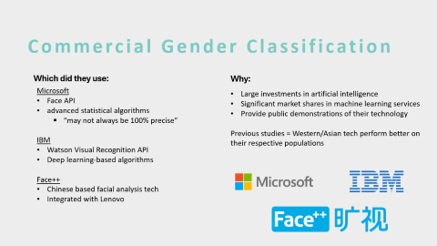
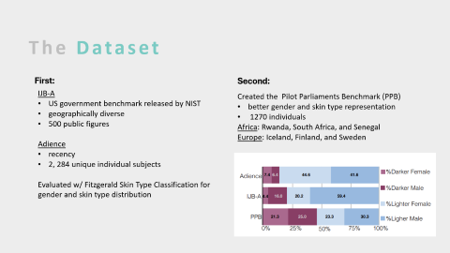
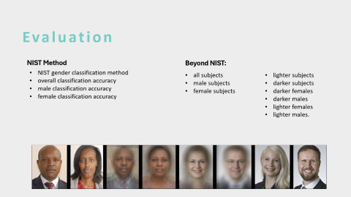
The Research

Slide 6
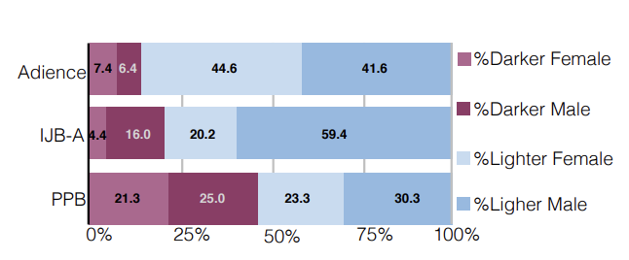
The Dataset
First:
Second:
IJB-A
US government benchmark released by NIST
geographically diverse
500 public figures
Adience
recency
2, 284 unique individual subjects
Evaluated w/ Fitzgerald Skin Type Classification for gender and skin type distribution
Created the Pilot Parliaments Benchmark (PPB)
better gender and skin type representation
1270 individuals
Africa: Rwanda, South Africa, and Senegal
Europe: Iceland, Finland, and Sweden

Slide 7



Commercial Gender Classification
Which did they use:
Why:
Microsoft
Face API
advanced statistical algorithms
“may not always be 100% precise”
IBM
Watson Visual Recognition API
Deep learning-based algorithms
Face++
Chinese based facial analysis tech
Integrated with Lenovo
Large investments in artificial intelligence
Significant market shares in machine learning services
Provide public demonstrations of their technology
Previous studies = Western/Asian tech perform better on their respective populations

Slide 8

Evaluation
NIST Method
Beyond NIST:
NIST gender classification method
overall classification accuracy
male classification accuracy
female classification accuracy
all subjects
male subjects
female subjects
lighter subjects
darker subjects
darker females
darker males
lighter females
lighter males.

Slide 9
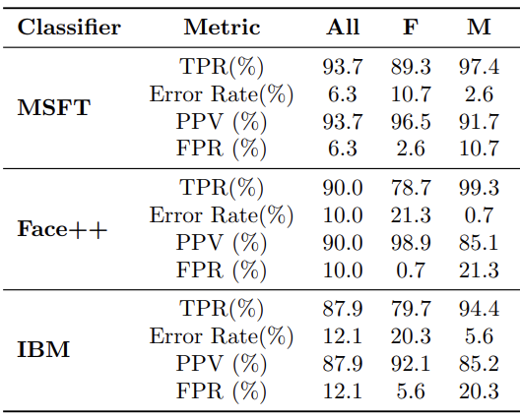
The Results
Racial Findings
Gender Findings
All classifiers perform better on lighter subjects than darker subjects in PPB.
microsoft achieves the best result
error rates of 12.9% on darker subjects
0.7% on lighter individuals
On darker subjects, IBM achieves the worst
error rate of 22.4%.
Rate is nearly 7 times higher than the IBM error rate on lighter faces
Differences between female and male classification error rates range from 8.1% to 20.6%
Microsoft and IBM:
FPR for males are triple or more than females
FPR for males is 30x of females with the Face++
All classifiers performed best for lighter individuals and males overall.

Slide 10
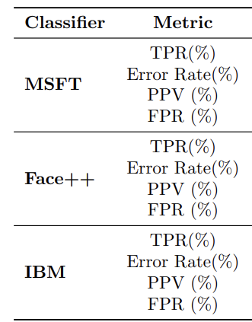
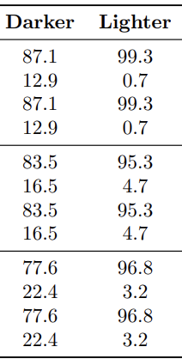
The Results
Racial Findings
Intersectional Findings
Gender Findings
All classifiers perform better on lighter subjects than darker subjects in PPB.
microsoft achieves the best result
error rates of 12.9% on darker subjects
0.7% on lighter individuals
On darker subjects, IBM achieves the worst
error rate of 22.4%.
Rate is nearly 7 times higher than the IBM error rate on lighter faces
Darker females the largest misclassified
21.% of PPB data,
61.0% to 72.4% classification error
Lighter males 30.3% of the benchmark
only 0.0% to 2.4% of the total errors from
All classifiers perform worse on darker females
Face++ is flawless on lighter males
IBM performs best on lighter females
Differences between female and male classification error rates range from 8.1% to 20.6%
Microsoft and IBM:
FPR for males are triple or more than females
FPR for males is 30x of females with the Face++
All classifiers performed best for lighter individuals and males overall.

Slide 11
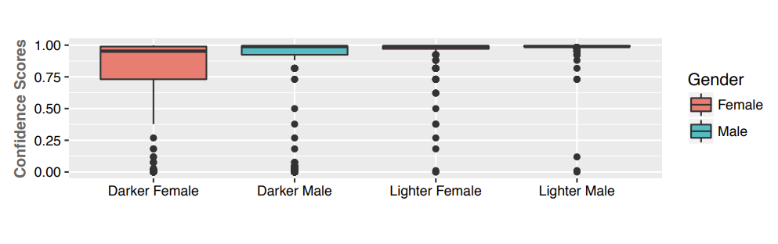
Discussion
The Results
Racial Findings
Gender Findings
Intersectional Findings
All classifiers perform better on lighter subjects than darker subjects in PPB.
microsoft achieves the best result
error rates of 12.9% on darker subjects
0.7% on lighter individuals
On darker subjects, IBM achieves the worst
error rate of 22.4%.
Rate is nearly 7 times higher than the IBM error rate on lighter faces
Differences between female and male classification error rates range from 8.1% to 20.6%
Microsoft and IBM:
FPR for males are triple or more than females
FPR for males is 30x of females with the Face++
All classifiers performed best for lighter individuals and males overall.
Darker females the largest misclassified
21.% of PPB data,
61.0% to 72.4% classification error
Lighter males 30.3% of the benchmark
only 0.0% to 2.4% of the total errors from
All classifiers perform worse on darker females
Face++ is flawless on lighter males
IBM performs best on lighter females
CC
CC
CC
CC
CC
CC
Takes into account:
Geographical location
Phenotypic labels
Needs to address:
Data consent
Model training
Images in paper

Slide 12
Discussion
CC
Any Ethical Considerations?
CC
Takes into account:
Fair, public use
Phenotypic labels
Needs to address:
Data consent
Model training
Images in paper
CC
CC
CC
CC

Slide 13
Discussion
CC
CC
Any Ethical Considerations?
Any Future Implications?
CC
CC
Takes into account:
Fair, public use
Phenotypic labels
Needs to address:
Data consent
Model training
Images in paper
Future Work:
Intersectional error of facial detection
AI Transparency
Inclusive benchmark datasets accuracy reports
close performance gaps
CC
CC

Slide 14
Discussion
CC
CC
CC
Any Ethical Considerations?
Any Future Implications?
Any Study Critiques?
CC
CC
CC
Takes into account:
Fair, public use
Phenotypic labels
Needs to address:
Data consent
Model training
Images in paper
Future Work:
Intersectional error of facial detection
AI Transparency
Inclusive benchmark datasets accuracy reports
close performance gaps
Pros:
Benchmark datasets comparisons
Various skin tones represented
Cons:
Face++ effect on own population
Reasoning of parliament integration in PPB

Slide 15


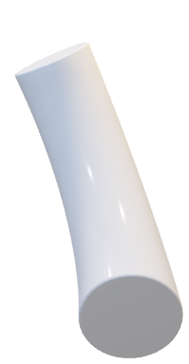

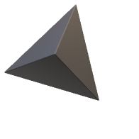

Thank You!
Conclusion
CC
Main Points
Algorithms are human made and thus are made with our bias
Increasing use with or to make decisions
Facial Recognition datasets do not encompass racial and gender intersectionality
Models will not be trained to handle and benefit all
Forward in addressing severe gaps in Algorithmic bias
Inclusive of diversity and intersectionality + spread more awareness
“Models are embedded historical practices”
- Cathy O’ Neil
CC
Thanks for listening!
Any Questions? :D

Slide 16
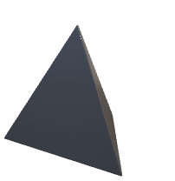
Thank You!
Thanks for listening!
Any Questions? :D

